Slide 1
Oral Health Directorate
Keeping connected in Oral Health
“Our success relies on our biggest asset - our staff”
The Oral Health Directorate is now in its fourth year of iMatter and it has become an integral part of our staff engagement. It is discussed at team meetings, during our regular staff update sessions and in our monthly team brief. Our response rate has increased from 73% to 78% and Employee Engagement from 81% to 84%. You Said - One of the main areas for improvement highlighted by teams during our feedback session last year was communication and the sharing of information across the Directorate. We Did - We took this on board and it resulted in the development of a new oral health intranet site. This demonstrates to staff the value of getting involved, their contributions are listened to, valued and acted upon.
The site helps staff to be:
Well informed
Information I need to do my job
Confident my ideas and suggestions are acted upon
“You Said We Did”:
Create New Intranet Site
The site is intended to be a resource that supports all staff by providing a variety of information and guidance on the services within oral health as well as a range of useful links and documents and has been found to be a very effective resource for staff induction.
But it’s not all work and no play on our site...... we have quizzes and competitions – the Christmas advent calendar quiz was a real challenge, we highlight any charity fundraising events ours staff are involved in and most of all we celebrate our successes.
Future plans
Clear accessible information for all
Referrals Guidance and Pathways
Access to services including emergency treatment
How to find a dentist
Build an external
website

Slide 2
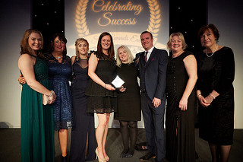
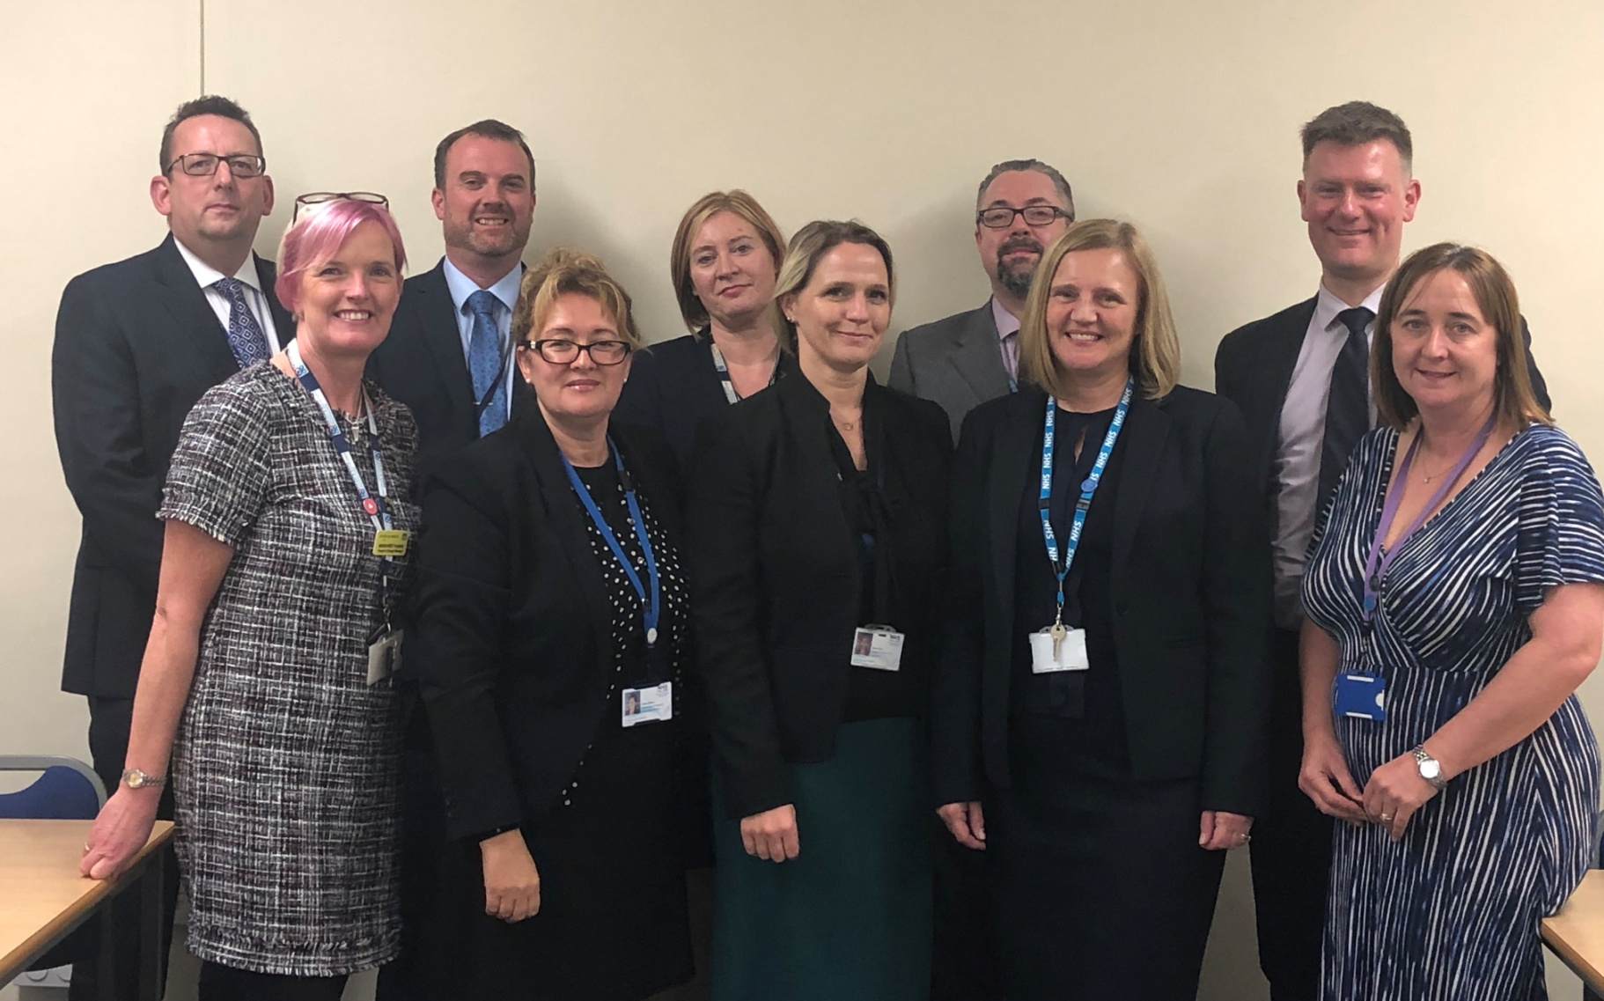
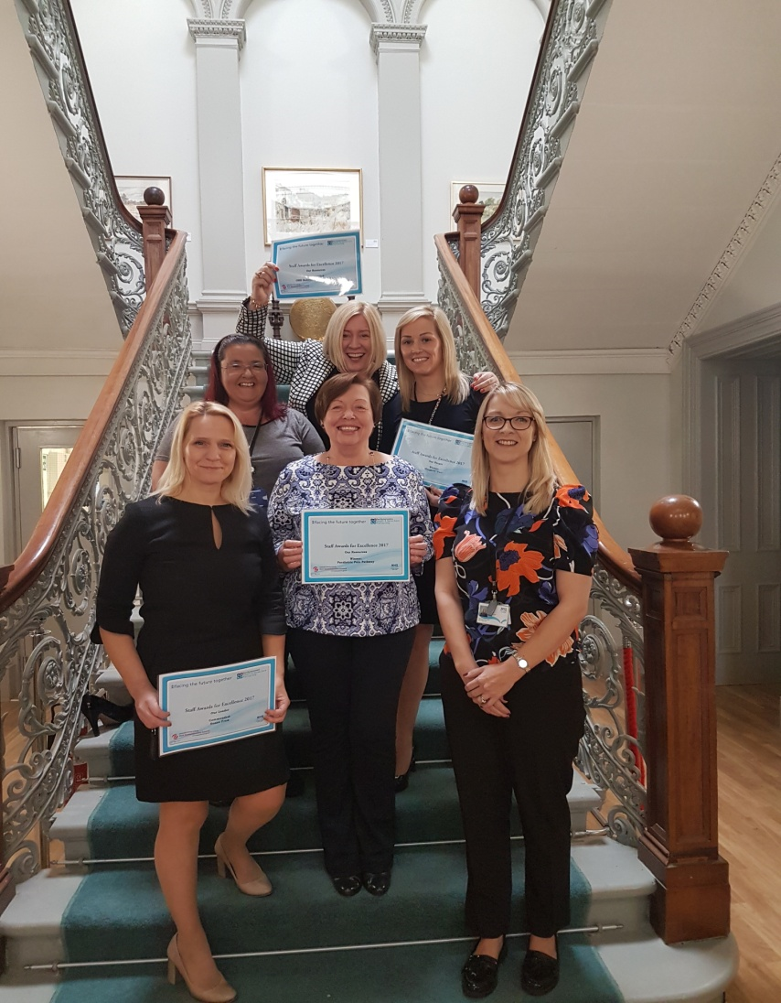
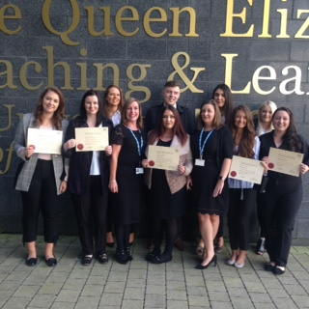
Oral Health Directorate
“Our success relies on our biggest asset - our staff”
“Highlights national campaigns”
“Let’s us celebrate our successes”
Well informed
Information I need to do my job
Confident ideas and suggestions are acted upon
“Useful training resource”
“Excellent for staff induction”

Slide 3
Oral Health Directorate
“Our success relies on our biggest asset - our staff”
What do our staff say?
Empowers people to make a difference
People can see the benefit of completing the survey and taking part in iMatter
Demonstrates SMT are responding to what is being said and suggested – You Said We Did
Good tool to show we are being listened to
More team ownership with iMatter which means the team can drive their own issues
Demonstrates that communication is a two way process

