Slide 1
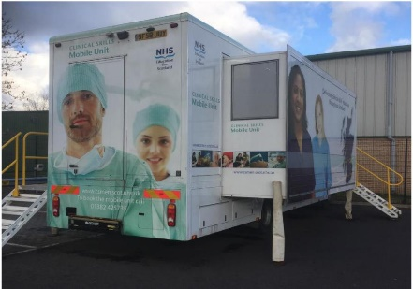
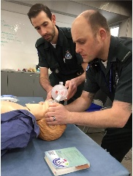
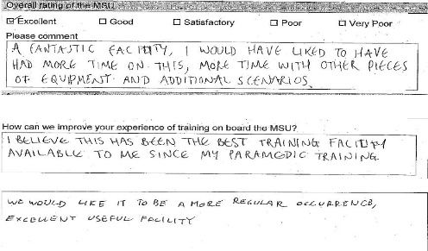
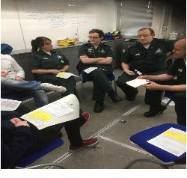
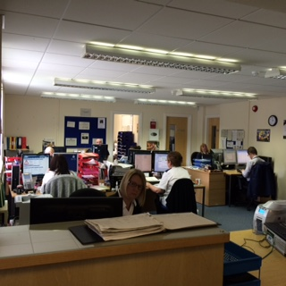
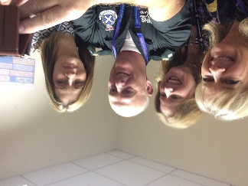
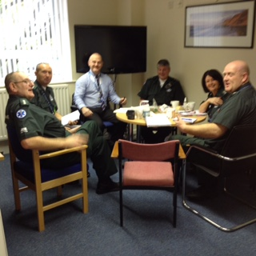
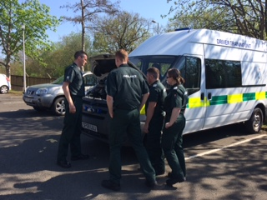
Everyone matters @Scottish Ambulance Service
Common themes from our iMatter results included more training and time to talk about learning and development as individuals
IDEA bring the clinical skills unit to the station for 2 weeks
Benefits
Staff confidence up
Feel more competent
Great reflective practice
Zero cost
New actions to repeat
Clinical skill programme and facility brought to the station designed by the team 60% of staff (n=72) attended over 2 week
Staff Feedback
More time for refection and development in
West region
Action Build into daily work
IDEA just schedule to make it happen
We made it happen
Feedback
Easy to try easy to do

